Slide 1

Portfolio Analysis and Volatility Prediction
DATA 690 Final Project
Submitted By:
Nirvika Rajendra
Mera Mathew

Slide 2
Project Objective
1
2
3
Classify market conditions into risk-based regimes to guide investment decisions
Optimize portfolio allocation using historical financial data
Model and predict portfolio-level volatility using machine learning

Slide 3
Introduction
In
In this project, we began by optimizing a portfolio using historical stock data. The goal was to find the ideal asset allocation that balances risk and return.
These weights are then used to train machine learning models (KNN and Random Forest) to predict portfolio volatility more accurately.
By applying a volatility threshold, the model classifies market conditions into "Invest" or "Avoid" regimes, supporting risk-aware investment decisions.
This flexible system combines financial theory and machine learning, allowing users to personalize portfolios and make data-driven choices aligned with their risk preferences.
The model is dynamic, adapting to changing risk conditions using rolling volatility.
Visualizations and classification metrics validate the model’s performance and help interpret regime shifts for practical application.

Slide 4
Motivation
The core motivation behind this project is risk management.
Volatility represents how much an asset's price fluctuates, which directly ties to the level of risk an investor takes on.
Portfolio weights are crucial here, they determine how much of each asset you hold, and they influence overall performance.
Combining volatility prediction with portfolio weights allows estimation of the portfolio’s future risk more precisely.
This dynamic approach captures changing market conditions, providing a realistic view of portfolio risk.
This gives us the power to adjust asset allocation proactively, minimizing exposure during risky periods
The ultimate goal is to make investment decisions that are not just profitable, but also resilient and risk-aware.

Slide 5








Analysis
METHODOLOGY :
DATA PREPARATION
Collected historical returns for selected stocks
Calculated mean returns and covariance matrix
PORTFOLIO OPTIMISATION - It is the process of selecting the best asset allocation to maximize returns while minimizing risk based on an investor’s goals and constraints.
Objective: – Maximize the Sharpe Ratio (risk-adjusted return) by finding the best combination of asset weights.
Constraints & Bounds: – Weights must sum to 1 (full investment) and lie within [0, 1], meaning no short selling or leverage.
Optimization Method: – Used SLSQP (Sequential Least Squares Programming) algorithm for constrained optimization.
APPLE (AAPL)
MICROSOFT (MSFT)
GOOGLE (GOOGL)
AMAZON (AMZN)
TESLA (TSLA)
SELECTED STOCKS
Data Source: Yahoo Finance via yfinance API
Date Range: Jan 1, 2020 to May 16, 2025
Data Type: Daily Close Prices
DATA SOURCE

Slide 6
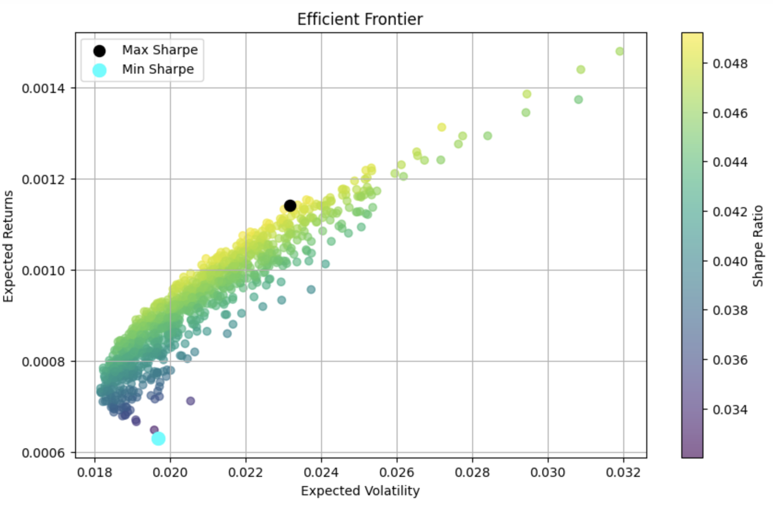
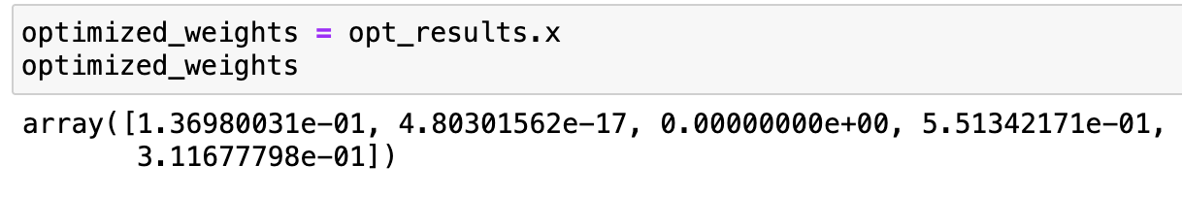
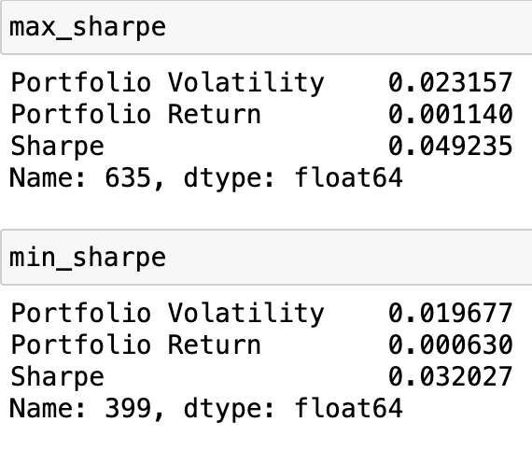
The Efficient Frontier illustrates the best risk-return trade-offs, highlighting the maximum Sharpe Ratio portfolio as the optimal risk-adjusted investment and the minimum Sharpe Ratio portfolio as the least efficient.
Optimized Weights Output:
- Final weights: AAPL = 13.7%,
MSFT = 0%,
GOOGL = 0%,
AMZN = 55.13%,
TSLA = 31.17%
- Indicates AMZN and TSLA dominate the optimal portfolio due to their strong return-to-risk profiles.

Slide 7
4. MACHINE LEARNING MODELS
After constructing the optimized portfolio, we trained two ML models, Random Forest and KNN to predict future volatility.
1. Feature & Target Engineering - Computed portfolio returns using optimized weights - Created lagged return features: last 5 days of returns - Target: Rolling volatility 5 days into the future (forward-shifted)
2. Train-Test Split - 80/20 split with no shuffling to preserve time sequence - Ensures model generalizes well on unseen future data
3. Model Training & Evaluation (Baseline) - Trained: Random Forest Regressor and K-Nearest Neighbors - Metrics: MSE (Mean Squared Error), R² Score
- Visualized: Actual vs. Predicted volatility for pattern accuracy
4. Hyperparameter Tuning (Random Forest)
- Used GridSearchCV with 5-fold cross-validation - Tuned: n_estimators, max_depth, min_samples_split - Selected best model based on lowest MSE
5. Final Model Evaluation - Re-trained Random Forest using best hyperparameters
- Evaluated again on test set (MSE, R²) - Compared with default and KNN models

Slide 8
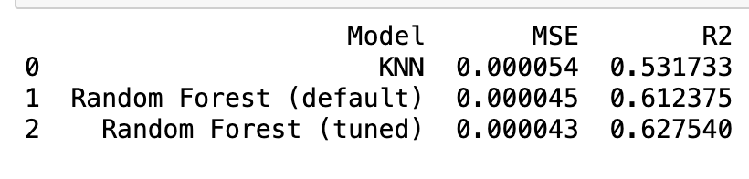
Findings
Volatility Prediction: Key Insights
This is the evaluation results of our volatility prediction models.
Tuned Random Forest outperformed all models - Achieved the highest R² (0.63) and lowest MSE (0.000043), confirming its superior ability to model the complexity of volatility dynamics.
Default Random Forest was a strong contender - Delivered R² of 0.61 and MSE of 0.000045, indicating it was already well-tuned and robust without hyperparameter optimization.
KNN showed moderate performance but lagged behind - With R² = 0.53 and MSE of 0.000054, it struggled to capture the non-linear patterns inherent in financial volatility.
Implication: Volatility is complex and non-linear - Tree-based models like RF are better suited for predicting volatility influenced by historical returns, correlations, and lags.
Why It Matters: Better volatility prediction = better risk control - Accurate forecasts enhance portfolio rebalancing, Sharpe ratio optimization, and regime-based investment strategies.

Slide 9
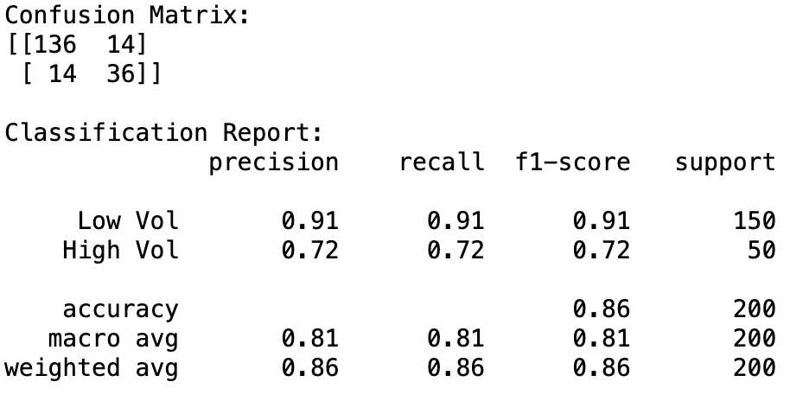
Findings
True Positives (36): Correctly identified high-volatility periods
True Negatives (136): Correctly identified low-volatility periods
False Positives (14): Incorrectly predicted high volatility when it was actually low
False Negatives (14): Missed high-volatility periods
Key Metrics
Precision (High Vol): 72% of predicted high-volatility periods were correct
Recall (High Vol): 72% of actual high-volatility periods were detected
Accuracy: 86% overall classification accuracy

Slide 10
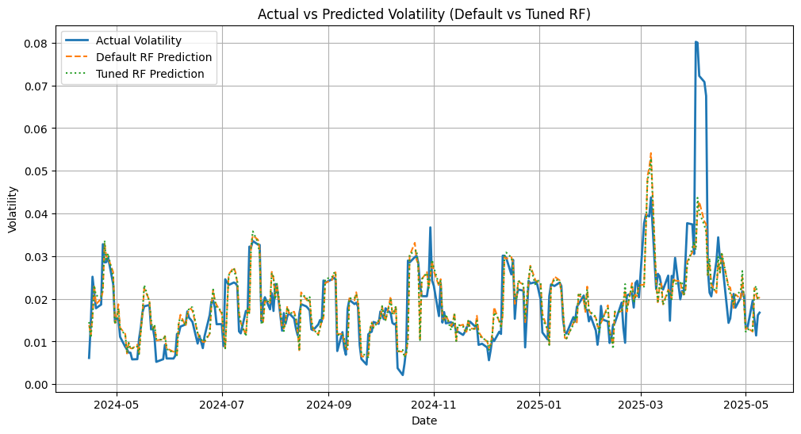
Insights
High Alignment with Actuals: Both default and tuned Random Forest models closely track actual market volatility over a 1-year period.
Strong Predictive Stability: Predictions remain smooth and consistent, avoiding overfitting or noisy fluctuations — critical for financial deployment.
Captures Volatility Spikes: Models effectively predict major volatility surges (e.g., March 2025), though with slight lag during rapid spikes.
Tuned Model Shows Edge: Hyperparameter tuning improves responsiveness to sharp changes, especially in high-volatility periods.
Low-to-Moderate Volatility Precision: Both models excel in calm market regimes, demonstrating high baseline accuracy.
Real-Time Readiness: Models are mature enough for integration into real-time dashboards or volatility-triggered risk controls.

Slide 11
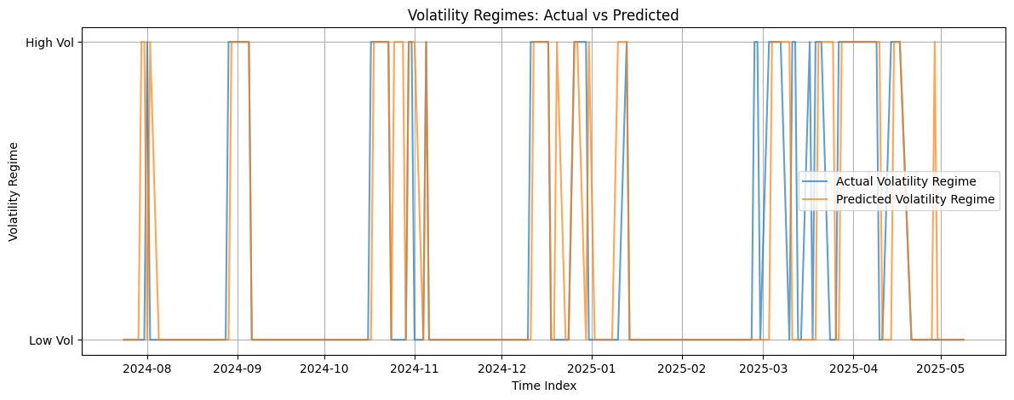
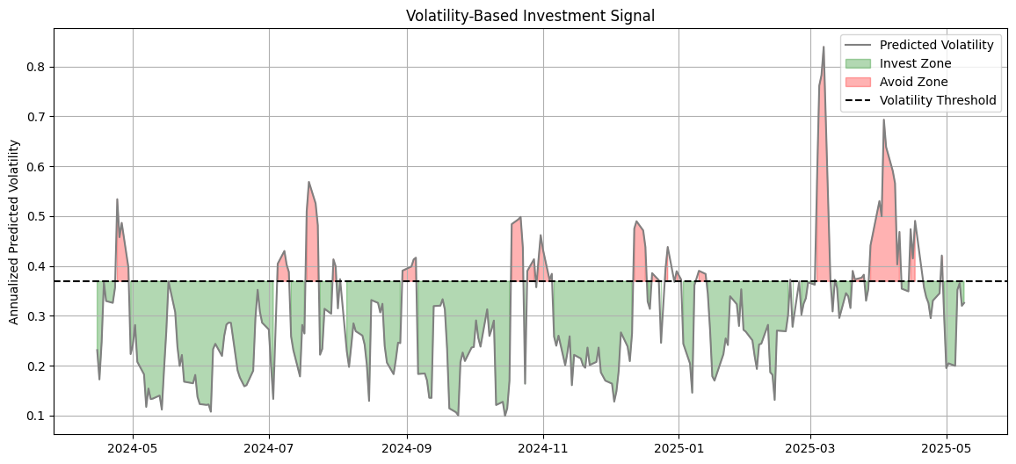
Volatility Regimes: Actual vs Predicted
Trend Capture: Model accurately tracks key regime shifts between high and low volatility periods.
Regime Distribution: Most periods fall into low volatility zones, with occasional sharp high-risk spikes (e.g., early 2025).
Minor Mismatches: Small lags or misclassifications appear near regime boundaries, common in fast market transitions.
Volatility-Based Investment Signal
Threshold-Based Logic: If predicted volatility >= 75th percentile (=0.361) -> High Risk, Else -> Low Risk
Risk Alerts: Red zones correspond to market stress, allowing pre-emptive portfolio rebalancing.
Mostly Investable: Majority of days fall in the investable zone, enabling frequent market participation

Slide 12
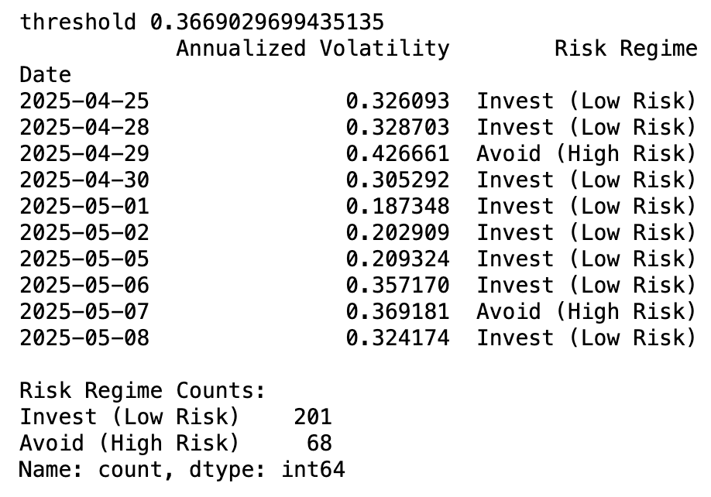
Volatility Regime Classification & Threshold Choice
Recent Regimes: - Invest (Low Risk): 201 days (~75%) - Avoid (High Risk): 68 days (~25%)
Threshold: 75th percentile of predicted volatility = 0.361 - Below threshold -> Invest (Low Risk) - Above threshold -> Avoid (High Risk)
Why 75th Percentile? - Captures the top 25% of volatility spikes (significant risk)
- Balances between too strict and too lenient cutoffs - Adapts dynamically to data distribution - Simplifies decision-making with clear risk zones
Impact: - Provides a practical, data-driven tool to identify safer vs. riskier market conditions - Helps investors adjust strategies proactively based on predicted risk

Slide 13
Conclusion
Predicting volatility and classifying risk regimes enables dynamic adjustment of portfolio exposure based on changing market conditions.
This approach simplifies complex volatility data into clear “Invest” or “Avoid” signals, making investment decisions more straightforward and actionable.
By combining machine learning predictive accuracy with portfolio optimization techniques, the method leverages the strengths of both data-driven forecasting and efficient asset allocation.
This integration allows for proactive portfolio adjustments that aim to maximize returns while effectively managing risk.
Ultimately, this combined approach supports practical and adaptive investment strategies, improving the potential for better risk-adjusted performance in diverse market environments.

Slide 14

FUTURE WORK
• Incorporate additional financial indicators (e.g., P/E ratio, volume).
• Use more advanced models such as XGBoost or LSTM for return prediction.
• Apply Monte Carlo simulation for forecasting future price paths.
• Include ESG or sector-based diversification strategies.

Slide 15
THANK YOU

